Slide 1

Sahil Raghuwanshi

Slide 2


ABOUT THE PROJECT
This project explore potential feature enhancement for Blinkit, a rapid grocery delivery platform. The proposed feature focus on two areas
Enhancing Product Discovery and Engagement: By encouraging users to explore a wider range of products through curated offers and promotions, driving increased interaction within the app.
Boosting Average Order Value (AOV): By presenting attractive deals and discounts, the feature motivates users to spend more time browsing and ultimately increase their purchase value.
The project aims to analyze the feasibility , user needs for implementing these features , balancing user satisfaction with business objectives.

Slide 3

UNDERSTANDING OF THE PRODUCT
About Blinkit
Mission
Blinkit is an online grocery delivery company that allows customers to place online orders for daily essentials and get them delivered to their doorsteps. From fruits to chicken to snacks to vegetables to pulses and bakery products, get everything in 10-25 minutes at your preferred location. In short, Blinkit is an eCommerce marketplace that makes grocery shopping extremely easy and comfortable.
To simplify grocery shopping by providing ultra-fast delivery of essentials, helping customers save time while offering convenience and affordability.
Key Partners
Key Resources
Key Statisticst
Intellectual properties and technologies
Online Sales and Delivery Platforms
IT and Communication Infrastructure
Delivery Channels: A network of local merchants/vendors
Funding rounds
GOV: ₹6132 Cr
Market Share: 47%
Total Revenue: ₹2.36 B
Cities: 28
GMV: ₹1.7 B
Total Orders: 39.2 M
Warehouses: 2,000
Dark Stores: 791
Local merchants and brands
Logistic Providers
Payment Providers
Investors
Acquisitions
Key Offeringst
Instant Grocery Delivery
Wide Product Range
Flexible Delivery Slot
Discount and Offer
Channel
Mobile App
Website

Slide 4
PROBLEM STATEMENT
Blinkit has achieved significant success in the quick commerce grocery sector, offering 10-minute deliveries in over 30 cities across India. Despite this, Blinkit’s customer retention rate has plateaued at around 45%, and its average order value (AOV) stands at ₹460, compared to Zepto’s ₹607.
Why do we need to solve this problem?
Business Objectives
Enhance customer retention rate which can impact Blinkit’s revenue
Increase AOV
Improve user satisfaction by addressing pain points and enhancing the overall experience
Improve Retention
Increase customer lifetime value for continued engagement
Boosting Customer Lifetime Value
Strengthen Blinkit’s position in the Quick commerce market to gain majority market share and increase revenue
Sustainable Competitive Advantage

Slide 5
PROJECT SCOPE & CONTEXT: APPLYING THE 5 W'S
Blinkit's existing and potential users, especially budget-conscious shoppers.
Target Audience:
Who?
Stakeholders:
Blinkit’s marketing team, product team, and consumers
WHAT?
'Sunday Sale' Feature: A weekly promotional campaign offering attractive deals, discounts, and interactive elements to boost engagement and AOV.
Every Sunday: With peak engagement activities like 'Flash Deals'
between 12 AM to 12 PM.
WHEN?

Slide 6
In a dedicated app section like 'Sunday Sale', pop-ups, and notifications
to ensure maximum visibility.
WHERE?
WHY?
Encourage bulk purchases with curated discounts,improve inventory management, and attract cost-conscious customers with attractive deals, Consistent Sunday promotions create a habitual shopping pattern.

Slide 7
USER INTERVIEW
What influences your decision to order groceries on weekends?
“On weekends, I have more time to plan meals and explore deals, so I tend to add extra items that I might not buy during the week.”
Do you prefer purchasing essentials or exploring deals on weekends?
“Weekends are when I explore new products or discounted items, especially if there’s a good offer.”
What factors encourage you to add more items to your cart?
“Discounts, combo deals, and seeing “limited-time offers” often tempt me to buy extra items.”
What challenges do you face while browsing grocery deals online?
“Sometimes the deals are scattered across categories, making it hard to spot the best offers. I’d prefer a clear ‘Sale’ section.”

Slide 8
INSIGHTS FROM USER INTERVIEWS
Users find deals scattered across categories, making it difficult to identify the best offers.
Weekends are seen as a time for relaxed browsing, making users more open to exploring deals and purchasing non-essential items.
Users expressed strong interest in a dedicated ‘Sunday Sale’ feature, suggesting it would help them plan weekly shopping better.
A dedicated sale section with clear categories would improve their shopping experience.
Seeing “limited-time offers” often encourages users to add more items to their cart.

Slide 9
USER PERSONA
Background: Rima works as a software engineer and follows a demanding weekday schedule. Due to her busy lifestyle, she often forgets to stock up on essential groceries and household items. On Sundays, she dedicates time to organizing her home, planning meals, and purchasing necessary items through quick commerce platforms like Blinkit.
Goals:
Find attractive discounts and bundle deals to save money.
Purchase fresh produce, snacks, and household essentials efficiently.
Access exclusive offers that reward her for bulk or planned purchases.
Pain Points:
Faces difficulty finding suitable deals during her rushed weekday purchases.
Struggles to get fresh stock during peak evening hours.
Feels frustrated with limited time to explore better offers.
Sima | College Student Age: 21 | Mumbai
RIya | Working Professional Age: 30 | Delhi
Background: Sima is a college student who attends classes from Monday to Saturday and has a busy schedule throughout the week. Due to her hectic routine, she often forgets to purchase essential items during weekdays. However, on Sundays, she is free and has ample time to explore deals, plan her purchases, and spend more time browsing shopping platforms like Blinkit.
Goals:
Save money by availing discounts and promotions on essential items.
Plan bulk purchases for the upcoming week on Sundays when she has sufficient time.
Discover new products and offers while spending time exploring the platform.
Pain Points:
Often forgets to buy important items during her busy weekdays.
Misses out on attractive deals due to lack of time to explore.
Finds it frustrating when preferred items are out of stock during peak hours.

Slide 10
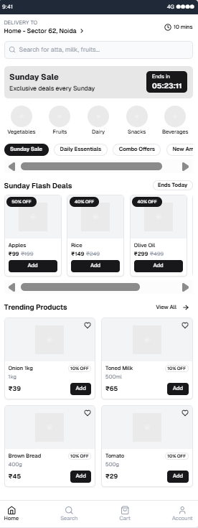
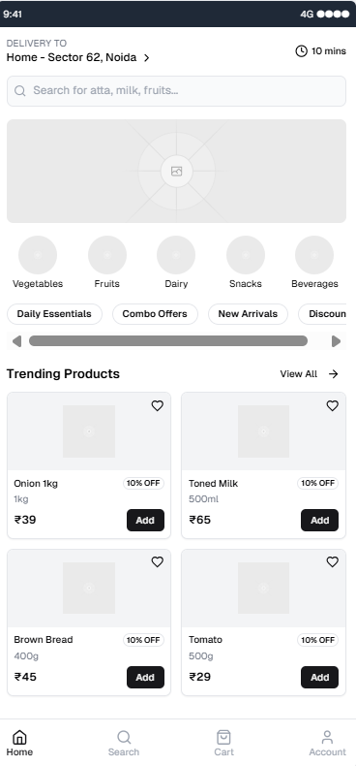
SOLUTION AND WIREFRAMING
Proposed Solution: 'Sunday Sale' Feature
To enhance user engagement, improve AOV, and strengthen customer loyalty, Blinkit will introduce a dedicated 'Sunday Sale' feature. This initiative will offer attractive deals and discounts across various product categories every Sunday, encouraging users to spend more time on the platform and increase their purchase volume.
Rationale for Introducing 'Sunday Sale'
User Behavior Insight: During weekdays, users typically prioritize urgent or essential purchases, limiting browsing time and resulting in lower AOV.
Sunday Advantage: On Sundays, consumers are generally more relaxed, willing to explore deals, and spend more time on shopping platforms. Leveraging this behavioral pattern can maximize engagement and increase basket size.

Slide 11
Execution Strategy
Curated Offers: Highlight popular categories such as snacks, beverages, household essentials, and personal care with dynamic discounts.
Gamified Experience: Introduce interactive elements like 'Spin the Wheel' for bonus discounts to boost excitement.
Exclusive Time Slots: Implement 'Flash Deals' during peak browsing hours (e.g., 12 PM to 6 PM) to drive urgency.
Personalized Recommendations: Leverage user data to showcase customized product bundles, encouraging bulk purchases.
Key Performance Indicators (KPIs)
AOV Growth: Track the percentage increase in order values during and after the 'Sunday Sale' campaign.
User Engagement: Monitor session duration and click-through rates on promotional banners.
Customer Retention: Measure repeat purchase rates over multiple sale cycles.

Slide 12
Thank
you!
Sahil Raghuwanshi

